Slide 1
SINHGAD COLLEGE OF ENGINEERING, PUNE – 41
DEPARTMENT OF INFORMATION TECHNOLOGY
Hierarchical Optimization of Optimal Path Finding for Transportation Applications
Presented by……………
Ashwini More B8238586
Punam Nerkar B8238589
Ramola Nikam B8238591
Shradha Pidhekar B8238605

Slide 2
Project Details
Group No : 28
Category : In house
Project Area : Data Structures
Project Platform : Windows, JAVA
Guided By…...
Prof. U.R.GODASE

Slide 3

Agenda
Introduction
Literature Survey
Problem Statement
Project Scope
Project Analysis
Project Design
Implementation(Algorithms)
Project Plan
Conclusions
References

Slide 4
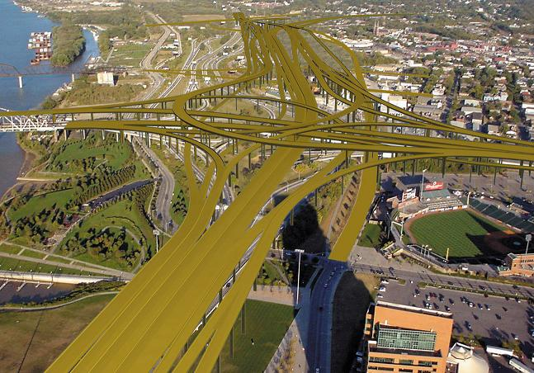
Introduction
Efficient path query processing
Study the problem in the context of automobile navigation systems
Precomputing Technique were used
Proposed HEPV

Slide 5
Literature Survey
Sr.no | Dijkstra | Transitive Closure | Hierarchical A* | HEPV
1 | On demand | Precompute | Both Precompute and On demand | Both Precompute and On demand
2 | No Fragments | No Fragments | Fragments | Fragments
3 | No Optimality Guaranteed | No Optimality Guaranteed | No Optimality Guaranteed | Optimality Guaranteed
4 | Can’t handle Large graph | Can handle Huge graph | Can handle Huge graph | Can handle Huge graph

Slide 6

Problem Statement
To find an optimal path for an individual to travel in an alien place such that intermediate nodes are revealed.

Slide 7

Project Scope
Propose a hierarchical graph model
Complete computation of paths on-demand and precomputed paths.

Slide 8
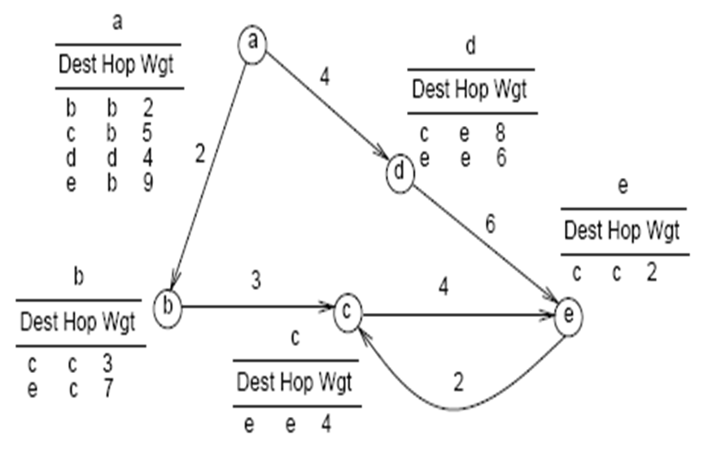
Encoded Path View Structure

Slide 9
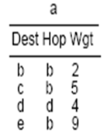
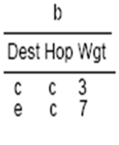

Encoded Path View Structure
PATH a-e
a
4
2
d
6
3
4
b
c
e
c
2

Slide 10
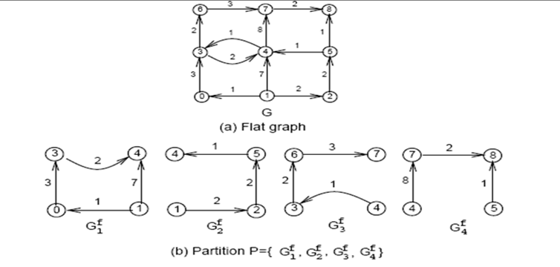
Proposed Algorithm : HEPV

Slide 11
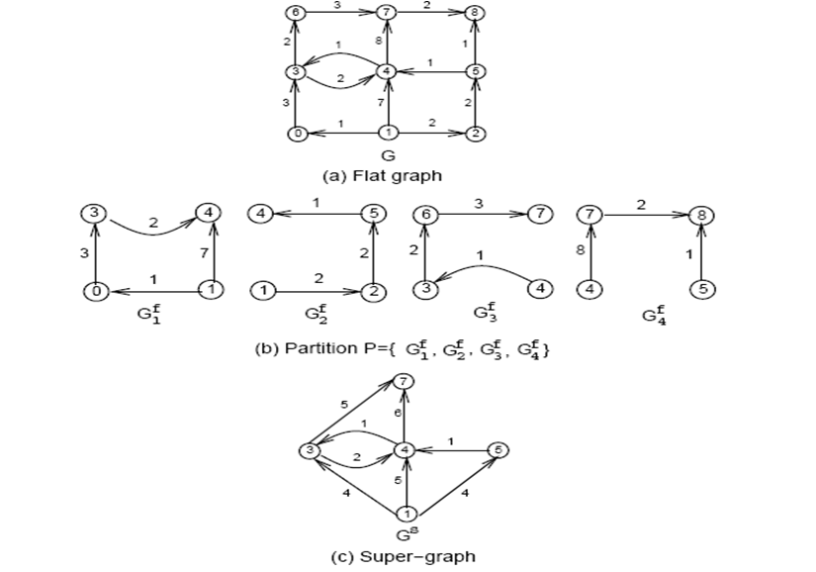
Proposed Algorithm : HEPV
Border Nodes
Local Nodes

Slide 12
Project Analysis
Use Case Level 1 Diagram
Additional Diagrams

Slide 13
Project Design
Data Flow Diagram
Entity Relationship Diagram
Sequence Diagram
State Transition Diagram

Slide 14
Data Flow Diagram
Create Partition
Extract Border Nodes
Border
Nodes
Create supergraph
Partition
Flat Graph
Partition
Supergraph
User
Partition
Supergraph
Source & destination
Source & destination
Source and destination
Check Source & destination
Retrieve Path
GUI
Status of
Source and
Destination
Minimum weight and path

Slide 15
Entity Relationship Diagram
LWEIGHT
DEST
WEIGHT
DESTI
HOP1
SOURCE
HOP
SRC
CREATE
1
FLAT GRAPH
*
PARTITION
*
WEIGHT1
DEST1
HOP2
PART NO
SOURCE1
CREATE
SUPERGRAPH
1

Slide 16
Sequence Diagram

Slide 17
State Diagram

Slide 18
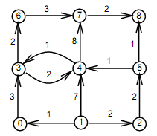
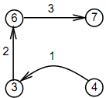
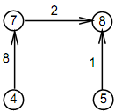
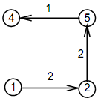
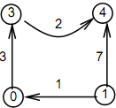
Hepv Creation Algorithm

Slide 19
Hepv Creation Algorithm
7
5
1
6
1
3
4
5
2
5
4
4
1

Slide 20
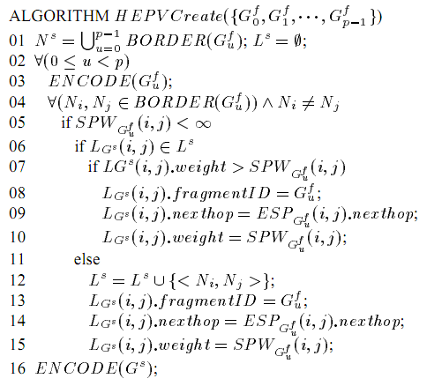
Hepv Creation Algorithm

Slide 21
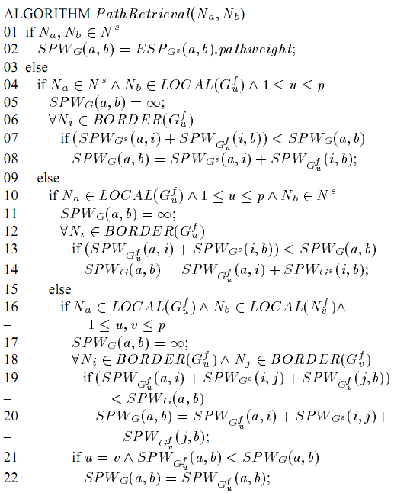
Path Retrieval Algorithm

Slide 22
Case 1
Source Node : Border Node
Destination Node: Border Node
7
5
1
6
1
3
4
5
2
5
4
4
1

Slide 23
Case 2
Source Node : Border Node
Destination Node: Local Node
7
5
1
6
1
3
4
5
2
5
4
4
1

Slide 24
Case 3
Source Node : Local Node
Destination Node: Border Node
7
5
1
6
1
3
4
5
2
5
4
4
1

Slide 25
Case 4
Source Node : Local Node
Destination Node: Local Node
7
5
1
6
1
3
4
5
2
5
4
4
1

Slide 26
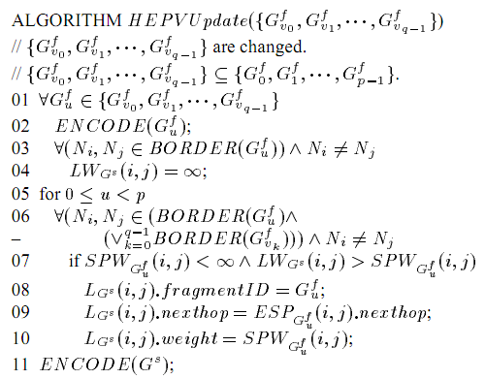
Hepv Update Algorithm

Slide 27
Project plan
Gantt Chart-I
Gantt Chart-II
Project Plan

Slide 28
Conclusions
Hierarchical graph model (HEPV) exploits path retrieving strategies
Algorithms are developed to create and maintain HEPV
Shortest path retrieval algorithm developed which can be shown to be optimal

Slide 29
References
[1] Ning Jing, Yun-Wu Huang, Elke Rundensteiner, “Hierarchical Optimization of Optimal Path Finding for Transportation Applications.”,pp. 1-8.
[2] R. Agrawal, S. Dar and H. V. Jagadish, “Direct Transitive Closure Algorithms: Design and Performance Evaluation,” ACM TODS, Vol. 15, No. 3, Sep. 1990, pp. 427 – 458.

Slide 30
References
[3] R. Agrawal and H. V. Jagadish, “Hybrid Transitive Closure Algorithms,” Proc. of the 16th VLDB Conf., 1990, pp. 326 – 334.
[4] T. Cormen, C. Leiserson, and R. L. Rivest, “Introduction to Algorithms,” The MIT Press, 1993.

Slide 31
Thank You…

